Slide 1
Retirement Income Pensions/Annuities Social Security/Railroad Retirement Benefits/ IRAs/401Ks
Pub 17 Chapter 10 & 11
Pub 4012 Tab D
(1040-Line 16)
(NJ 1040-Lines 19a & 19b)
Notes:
1

Slide 2
Types Of Retirement Income
Pensions & 457 plans
Including disability income post retirement age
Annuity/Insurance Contracts
Social Security (covered in later module)
Railroad Retirement Benefits
Tier 1 – Social Security equivalent (covered in later module)
Tier 2 – Pension equivalent
IRAs
401k, 403b, Thrift Savings Plans
Notes:
2

Slide 3
Retirement Income Definitions
Pension (including 457 plans):
Periodic payments made to employee (or survivor) after retirement from work
Annuity:
Payments received by taxpayer under contract from insurance company, trust company or individual
IRA (Individual Retirement Account):
Self-managed personal tax-deferred savings plan
401k:
Employer sponsored & managed tax-deferred retirement savings plan (Wages are still subject to SS & Medicare Taxes)
403b:
Retirement savings plan for public education, some non-profit, cooperative hospital service organizations, and self-employed ministers
Notes:
3

Slide 4
IRAs – Individual Retirement Accounts
Different types of IRAs
Traditional IRA
IRA with deductible contributions
IRA with non-deductible contributions
Roth IRA
Simple IRA (Savings Incentive Match Plans for Employees) Out of Scope when contributions are made
SEP IRA (Simplified Employee Pension) Out of Scope when contributions are made
Notes:
4

Slide 5
Reporting IRA Contributions to Taxpayer
Custodians/Trustees must issue a Form 5498 to report contributions to an IRA
Reports deductible and nondeductible contributions, conversions, rollovers
Separate Form 5498 for each IRA account to which contributions were made in a year
Don’t actually enter Form 5498 into TaxSlayer but information needed to complete Form 8606 for non-deductible contributions

Slide 6
Traditional IRA
Must have earned income & be < 70½ to contribute
Federal rules:
Contributions tax deductible in the year made for Federal
Current limit – $5,500/$6,500 if >/= 50 years of age
May be reduced based on retirement plan, filing status, income
Contributions can be made up to tax return due date & applied retroactively to tax year
Discussed in depth in Adjustments module
Earnings accumulate tax deferred
Distributions taxable in the year received
Notes:
6

Slide 7
Traditional IRA
(cont’d)
NJ rules:
Contributions to IRA are not deductible in the year made
Therefore, contributions may not be taxable when distributed
Earnings accumulate tax deferred, but earnings taxed when distributed
Required Minimum Distribution (RMD) by April 1 following year taxpayer turns 70½ (or 50% penalty)
If born on or before 6/30 - Take RMD by 12/31 of that year, to avoid having to take double RMD the next year
Notes:
7

Slide 8
Traditional IRA with Non-Deductible Contributions
Non-deductible contribution is difference between permitted contribution and amount allowed for IRA deduction
Alternative when IRA deduction is limited due to retirement plan, income, filing status
Total of deductible + non-deductible cannot exceed maximum contribution limits ($5,500/$6,500 if >/= 50 years of age)
Distributions from IRAs with non-deductible contributions
Deductible contributions taxed on distribution
Non-deductible contributions not taxed on distribution
Earnings are taxed on distribution
Notes:
8

Slide 9
Traditional IRA with Non-Deductible Contributions
(cont’d)
Non-deductible contributions must be tracked on Form 8606 and filed with tax return at time of contribution in order to be tax exempt on distribution
IRAs with non-deductible contributions can be very complex, so refer to experienced counselor
Refer to “IRA Non-Deductible Contributions and Distributions” document on TaxPrep4Free.org Preparer page
Notes:
Form 8606 allows the client to track the non-deductible contributions
Creates a basis
Should be completed and sent to IRS
Client should bring to tax appointment
If clients didn’t fill out an 8606 when contributing year by year, it is possible to file the form late (with penalty of $50/yr)
If you don’t have 8606 filed by the time you take distributions, it’s too late to file it and you can’t get the benefit of tax-free distribution
9

Slide 10
Roth IRA
Can include:
After-tax contributions
No age limit for contributions, but must have earned income
Dollar limits on contributions same as for Traditional IRA ($5,500/$6,500 if >/= 50 years)
Money converted from a Traditional to Roth IRA
No income limits for who can convert
Pay tax when contribution is converted
Notes:
10

Slide 11
Roth IRA
(cont’d)
No Required Minimum Distribution (RMD)
Amounts withdrawn from Roth IRA cannot be used to satisfy RMD for Traditional IRA
Earnings accumulate tax free (not just tax deferred)
Distributions are generally not taxable
Exception: Distribution within 5-yr qualifying period from date Roth IRA was first established may be subject to tax on earnings plus 10% early distribution penalty
Rules for taxability of distributions are the same for NJ
Notes:
11
Explain that “tax free” means never having to pay tax; “tax deferred” means you can put off paying the tax, but you must pay tax in the future

Slide 12
Traditional IRAs & Roth IRAs
 | Traditional IRA | Non Deduct Cont. | Roth IRA
Contributions | Tax deductible in year made (up to limits) Dollar limit on contributions Allowable up to tax return due date & apply retroactively to tax year Must have earned income & be < 70½ | After-tax contributions | After-tax contributions Dollar limit on contributions No age limit for contribution Must have earned income
Earnings | Earnings accumulate tax deferred until withdrawn | Earnings accumulate tax deferred until withdrawn | Earnings accumulate tax free
Distributions | Distributions taxable in year received | Distributions include contributions & earnings (Contribution portion not taxed, earnings taxed) | Distributions tax free

Slide 13
Traditional IRAs & Roth IRAs
(cont’d)
 | Traditional IRA | Non Deduct Cont. | Roth IRA
Penalties | 10% penalty if withdrawal prior to age 59½ (Exceptions include: death, disabled, excessive medical expenses, used for qualified first-time home purchase, higher education) 6% penalty on excess contributions |  | 10% penalty for distributions prior to age 59½ or if did not meet five-year requirement (Exceptions, include: death, disabled, excessive medical expenses , used for qualified first-time home purchase, higher education)
Required Minimum Distribution (RMD) | RMD mandatory by April 1 following the year taxpayer turns 70½ (or 50% penalty) |  | No RMD
Notes:
13

Slide 14
401k Plans
Employer-sponsored plans
Pre-tax contributions (99.9% of cases)
If any contributions were after-tax (unusual), distributions are Out Of Scope
Earnings accumulate tax deferred
Distributions taxable in the year received
Required Minimum Distribution (RMD) by April 1 following the first year after the later of:
Year taxpayer turns 70½ OR
Year in which taxpayer retires
Contributions are pre tax in NJ starting 1/1/84
Notes:
14

Slide 15
Types of Retirement Income Tax Forms
1099-R | Pensions, Annuities, Retirement Plans, Insurance Contracts
SSA-1099 | Social Security Payments *
RRB-1099 | Social Security Equivalent or Tier 1 *
RRB-1099-R | Non-Social Security Equivalent or Tier 2 *
* Covered in later section
Notes:
15

Slide 16
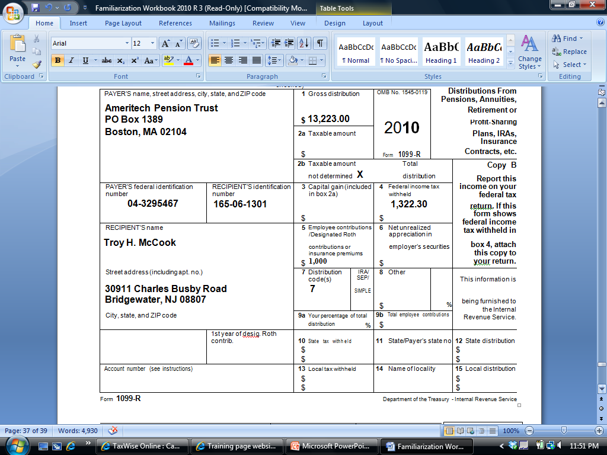
Sample 1099-R
Gross distribution
8,223
2016
Total distribution
Taxable amount not determined
Federal tax withheld
822
Diane Davis
Distribution code
210 Main Street
Bridgewater, NJ 08807
IRA designation
10,000
Notes:
This is a sample 1099-R showing how pension/annuity/IRA income is reported
Notice that Box 5 can contain different information – Employee contributions/Designated Roth contributions OR insurance premiums
16

Slide 17
1099-R Distributions
Taxability of distributions computed separately for each 1099-R
Gross distribution shown in Box 1
Taxable amount of distribution shown in Box 2a
If taxable amount not shown, must complete Simplified General Rule Worksheet to determine how much of distribution is taxable
If “Taxable Amount Not Determined” box is checked, but there is an amount in Box 2a on the 1099-R, enter that amount in TaxSlayer Box 2a and do not use Simplified General Rule Worksheet
Lump sum distribution
Shown to right of Box 2 on Form 1099-R “Total Distribution”
Employee contributions in Box 5 are normally the non-taxable portion of the yearly distribution. Box 5 + Box 2 = Box 1
For CSA/CSF Form 1099-R (Civil Services Retirement Benefits), the amount in box 5 is for health insurance premiums. Needs to be manually entered into Schedule A Medical Expenses
Notes:
17

Slide 18
1099-R Distributions
(cont’d)
Box 7 is checked if distribution is from an IRA/SEP/Simple plan
IRA distributions are reported on a different line (1040 Line 15) than pension/annuity distributions (1040 Line 16)
All 1099-R distributions are reported on NJ 1040 Line 19
Total Employee Contributions in Box 9b – the amount reported here is not taxable but must be allocated across expected life of pension
Used when completing Simplified General Rule Worksheet
IRA contributions not taxed in NJ when distributed (after-tax contributions)
NJ taxes certain 1099-R distributions differently than Federal
Military pensions taxable for Federal, tax exempt in NJ *
Railroad Retirement pensions taxable for Federal, tax exempt in NJ *
Disability pensions for people under company minimum retirement age are treated as taxable wages for Federal, while tax exempt in NJ for people under 65
* Covered in later slides
Notes:
18

Slide 19
TS – Distribution from Retirement Plan – Form 1099-R Federal section \ Income \ Enter Myself \ IRA/Pension Distributions (1099-R, 1099-SSA) \ Add or Edit a 1099-R
Enter Payer ID. If TaxSlayer
populates name & address,
verify. Changes frequently.
Gross distribution
Taxable amount (TSO
Populates based on Box 1;
correct if necessary
Taxable amount not determined
Total distribution
Notes:
TaxSlayer screen must match exact info from printed 1099-R form
Check whether 1099-R is for taxpayer or spouse
Enter Payer’s ID from 1099-R form
TaxSlayer will populate Payer’s name & address based on ID if it can. Otherwise, type in
If Payer’s info is pre-populated, still must check carefully to see if info has changed (address frequently does)
TaxSlayer will populate Recipient’s address from Basic Information section
Enter data from printed 1099-R into same boxes on TaxSlayer screen
If this is a total distribution, check box
Be sure to enter any codes in Box 7. Also check IRA/SEP/Simple1099-R box if this is an IRA distribution
If Taxable Amount Not Determined box is checked & Taxable Amount in Box 2 is not populated, use Simplified Method Worksheet to determine taxable amount for Federal or use Bogart Annuity Calculator on TaxPrep4Free.org Preparer page
TaxSlayer will transfer gross amount of pension to 1040 Line 16a & taxable amount to Line 16b; if distribution is from an IRA (based on check in box 7), gross amount will transfer to Line 15a & taxable amount to Line 15b
19

Slide 20
TS – Distribution from Retirement Plan – Form 1099-R Federal section \ Income \ Enter Myself \ IRA/Pension Distributions (1099-R, 1099-SSA) \ Add or Edit a 1099-R
(cont’d)
Federal tax withheld
Distribution code
Check if IRA
Amount employee contributed
to pension
Notes:
20

Slide 21
Distribution from Retirement - Form 1099-R – TS Tips
Enter 1099-R income in Federal section \ Income \ Enter Myself \ IRA/Pension Distributions (1099-R, 1099-SSA) \ Add or Edit a 1099-R
Enter information from 1099-R into matching boxes in TaxSlayer
TaxSlayer uses the amount in Gross Distribution amount in Box 1 as the Taxable Amount in Box 2a unless you change 2a
TaxSlayer will always use the amount in Box 2a as the taxable amount on the Federal return
If “Taxable Amount Not Determined” box is checked & Taxable Amount in Box 2a is not populated on 1099-R:
Check box in 2b to indicate that taxable amount is not determined
Use Simplified General Rule Worksheet to determine taxable amount for Federal. Click on “Options” link under Box 2a. Once Worksheet is completed, TaxSlayer will transfer the result into 2a
Can also use Bogart Annuity Calculator on TaxPrep4Free.org Preparer page to determine taxable amount (must enter result manually in 2a)
Notes:
21

Slide 22
Distribution from Retirement Form 1099-R – TS Tips
(cont’d)
If total distribution, check box in 2b
Enter any codes in Box 7
For IRA distributions - check IRA/SEP/Simple 1099-R box
TaxSlayer transfers gross amount of pension to 1040 Line 16a & taxable amount to Line 16b; if distribution is from an IRA (based on check in box 7), gross amount will transfer to Line 15a & taxable amount to Line 15b
Taxable amounts from Federal 1040 Lines 15b and 16b transfer to NJ 1040 Line 19a
Notes:
22

Slide 23
Pension & Annuity Partially Taxable Distribution - Simplified General Rule Worksheet
Used to determine taxable/nontaxable portion of pension/annuity if taxable amount is not given in 1099-R Box 2a
Employee after-tax contribution divided by total number of expected payments based on life expectancy
Used when:
“Taxable Amount Not Determined” box is checked on 1099-R
IRA box is not checked on 1099-R
Box 2a of 1099-R is not populated
If “Taxable Amount Not Determined” box is checked but Box 2a is populated, assume Box 2a value is correct
Link to Simplified General Rule Worksheet from 1099-R screen or use Bogart Annuity Calculator on TaxPrep4Free.org Preparer page
Notes:
23

Slide 24
Pension & Annuity Partially Taxable Distribution - Simplified General Rule Worksheet
(cont’d)
Taxpayer needs to know:
Annuity starting date & taxpayer contribution to plan
Age when annuity started
Also spouse’s age if joint and survivor annuity
Prior year cumulative tax-free amount if annuity started after 1986. If not available, calculate the amount by using monthly tax-free amount calculated on worksheet for 2017 times the number of months prior to 2017
Pre-1987 starting date - tax exclusion can exceed cost & is available each year
1987 or later starting date - tax exclusion is limited to cost
Notes:
24

Slide 25
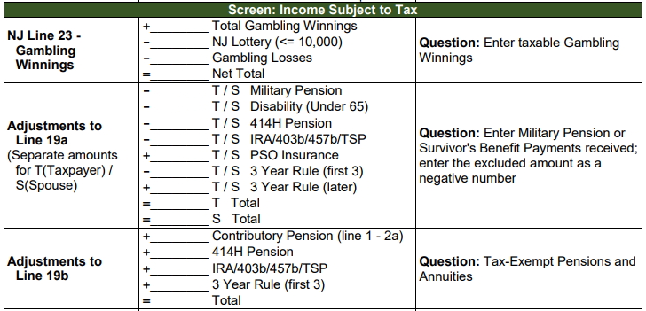
Pension & Annuity Partially Taxable Distribution - Simplified General Rule Worksheet
(cont’d)
Capture non-taxable amount in NJ Checklist Income Subject to Tax section for later entry in the TaxSlayer State section (NJ 1040 Line 19b)
Notes:
25

Slide 26
Pension & Annuity Distribution Simplified General Rule Special Case
Joint and survivor pension and primary annuitant dies before beginning to receive pension
At a later date, secondary annuitant starts to receive benefits from the pension
Must use secondary annuitant date of birth & date when secondary annuitant started receiving benefit in Simplified General Rule Worksheet (instead of dates for primary annuitant)
Notes:
26

Slide 27
TS – Options for Calculating Taxable Amount of Pension Distribution – Form 1099-R Federal section \ Income \ Enter Myself \ IRA/Pension Distributions (1099-R, 1099-SSA) \ Add or Edit a 1099-R
Click to figure out taxable
amount using Simplified General Rule Worksheet
Taxable amount not determined
Not an IRA
Employee contributions
Notes:
27

Slide 28
TS – Calculating Taxable Amount of Pension Distribution Federal section \ Income \ Enter Myself \ IRA/Pension Distributions (1099-R, 1099-SSA) \ Add or Edit a 1099-R \ Calculate Taxable Amount
Click to figure out taxable amount using Simplified General Rule Worksheet
Notes:
28

Slide 29
TS - Simplified General Rule Worksheet Federal section \ Income \ Enter Myself \ IRA/Pension Distributions (1099-R, 1099-SSA) \ Add or Edit a 1099-R \ Calculate Taxable Amount \ Simplified General Rule Worksheet
Cost basis when pay-outs started (from 1099-R Box 9b)
Annuity starting date
Check if joint or survivor annuity
Age when pay-outs started (not current age);
Add ages of spouses if joint or survivor annuity
# of months paid in current year
Amounts recovered in prior years
Use this worksheet to determine taxable/nontaxable portion of retirement distribution
Notes:
This worksheet used to determine the taxable/non-taxable portion of the retirement distribution, based on taxpayer’s original contributions to pension/annuity (in 1099-R Box 9b). These contributions were taxed when contributed; therefore, they should not be taxed again on distribution. Contributions must be recovered equally over the course of the pension’s expected life; cannot all be recovered up front before taxable portion
TaxSlayer automatically populates gross distribution amount from 1099-R
Enter plan cost at annuity start date (from Box 9b of 1099-R)
Check box if joint or survivor annuity
Enter age when pay-outs started (NOT today’s age). Add ages of spouses if joint or survivor annuity
Enter # of months for which payments were received in current year
Enter amount received tax free in prior years (from last year’s return or taxpayer)
TaxSlayer will calculate how much of amount can be excluded from income & how much will remain to be excluded for future years’ calculations
Exclusion amount will be the same for all full years of pension distribution; could be different for first & last years of distribution since they may not be full years
29

Slide 30
Simplified General Rules Worksheet - TS Tips
TaxSlayer populates gross distribution amount from 1099-R screen
Enter cost basis in plan when payouts started
From 1099-R Box 9b
Check joint or survivor annuity box if appropriate
Enter age of primary recipient at starting date of payouts (NOT current age) or enter combined ages if joint or survivor annuity
Enter # of months for which payments were received in current year
Enter amount received tax free in prior years
From last year’s return or taxpayer
If not known, multiply the monthly excludable amount that TaxSlayer calculates on this worksheet for the current tax year by the number of months pension was received prior to current year
Notes:
30

Slide 31
Simplified General Rules Worksheet - TS Tips
(cont’d)
TaxSlayer calculates how much of distribution amount is taxable and populates Box 2a on 1099-R screen
TaxSlayer calculates remaining cost in pension or annuity for future years’ calculations
Amount of employee contributions still not recovered tax free
Once remaining cost reaches 0, all distributions are taxable (for pension pay-outs starting in 1986 or later)
TaxSlayer adds gross distribution amount to 1040 Line 16a and taxable amount to Line 16b
Simplified Method Worksheet is included in print package for taxpayer’s records (not e-filed to IRS)
Notes:
31

Slide 32
TS – Annuity/Pension Exclusion Calculator - Simplified General Rule Worksheet Bogart Annuity Calculator / TaxPrep4Free.org Preparer page
Manually enter taxable amount on 1099-R Box 2a in TaxSlayer
Notes:
This is an annuity calculator built by Jeff Bogart. In a number of respects, it is better to use than the Simplified Method Worksheet built into TaxSlayer
You can put in birth dates, and the calculator will automatically figure out the ages
It calculates for you what taxable amount to put in 1099-R Box 2a
It tells you amount previously recovered and how much is left to recover in future years. Also tells you when you will finish recovering all your contributions
Print out a copy of these calculations for use by Quality Reviewer. Put in taxpayer’s envelope for next year’s return
Don’t forget to manually enter the taxable amount of the pension in Box 2a in TaxSlayer
32

Slide 33
TS - Nontaxable Portion of Retirement Distribution – Simplified General Rule Worksheet Bogart Annuity Calculator on TaxPrep4Free.org Preparer page
(cont’d)
Shows you amount of distribution that can be excluded from tax every year
Notes:
This shows you how much of taxpayer’s contribution can be excluded each year and how much is left to recover
This is especially helpful if you don’t have prior year’s return to determine what has already been recovered
33

Slide 34
TS – Taxable Amount of 1099-R Distribution Based on Simplified General Rule Worksheet Federal section \ Income \ Enter Myself \ IRA/Pension Distributions (1099-R, 1099-SSA) \ Add or Edit a 1099-R
Gross distribution
Taxable amount of distribution
TaxSlayer populates based on Simplified General Rule Worksheet OR
Counselor enters amount from Bogart calculator
Notes:
34

Slide 35
TS - Retirement Income on 1040 Line 16
Taxable amount of distribution
Gross distribution
Notes:
Line 16a includes Pensions, Annuities & 401Ks
TaxSlayer transfers total retirement distribution from 1099-R screen to 1040 Line 16a
TaxSlayer transfers taxable portion of retirement distribution from 1099-R screen to 1040 Line 16b
35

Slide 36
TS – Simplified Method Worksheet in PDF Packet for Taxpayer Records
Gross distribution
Taxable amount
Amount recovered through current year;
needed for next year’s worksheet
Balance still to be recovered
Notes:
This Worksheet is included in the PDF generated for the tax return. It can be kept for the taxpayer’s records and used the following year. Line 10 gives you the amount recovered through the current tax year
36

Slide 37
1099 Distributions – Exclusions from Taxable Income
Certain types of distributions of retirement income may be excluded from taxable income
Rollovers
Public safety officer accident/health/long-term care insurance premiums
Tax-free exchanges
E.g. – Return of contributions paid into an annuity
Notes:
37

Slide 38
Rollovers
Money transferred from one tax-deferred account into another (e.g. – 401k to IRA or IRA to another IRA)
Entries on tax documents and treatment in TaxSlayer depend upon circumstances of transfer
Counselor needs to fully understand what occurred
Three common scenarios we see
Direct IRA trustee-to-trustee transfer
Direct rollover from a qualified retirement plan (Taxpayer does not receive money)
60-day indirect rollover (Taxpayer receives money)
Notes:
38

Slide 39
Direct IRA Trustee-to-Trustee Transfer
Transfer of assets from IRA under one trustee to IRA under a different trustee without taxpayer ever taking control of money
No limit on how many can be done in one year since not officially considered a rollover
Can be done electronically (receiving trustee requests from original trustee) or distribution check can be issued in name of receiving trustee (not in taxpayer’s name)
Not reported on 1099-R
Not a taxable event; nothing in TaxSlayer
Receiving trustee does not issue a Form 5498 to show how much was received
Notes:
The easiest way for a taxpayer to transfer money from one trustee to another is to go to new trustee & ask for this to be done electronically
39

Slide 40
Direct Rollover from a Qualified Retirement Plan (Taxpayer Does Not Receive Money)
Transfer of assets from a qualified retirement plan (e.g. – 401k) into an IRA (or another qualified retirement plan) - Taxpayer does not receive money
Reported on 1099-R with Code G in Box 7
Enter 1099-R in TaxSlayer as normal
Enter 0 as taxable amount in Box 2a
Check box that says, “Check here if all/part of the distribution was rolled over, and enter the rollover amount”
Enter the amount rolled over. TaxSlayer will not include that amount on 1040 Line 16 as taxable
Form 5498 may be issued by receiving plan with amount received in Box 2
Do nothing with Form 5498 in TaxSlayer
Notes:
Situation could happen when you retire
40

Slide 41
Indirect 60-Day IRA Rollover (Taxpayer Receives Money)
Assets in IRA are liquidated, check made out to taxpayer, funds are re-deposited with another trustee
Original trustee reports distribution on 1099-R as a normal distribution since it does not know what taxpayer will do with the money
If re-deposited in another IRA within 60 days, considered non-taxable
Can make only one rollover from one IRA to another or one Roth IRA to another Roth IRA in any 12-month period, regardless of the number of IRAs owned
If more than one rollover, distributions after first become taxable. May incur 10% early withdrawal penalty
Notes:
This frequently happens when taxpayer goes to original trustee and closes out IRA. Then goes to a new trustee & opens a new IRA
41

Slide 42
Indirect 60-Day IRA Rollover (Taxpayer Receives Money)
(cont’d)
Limit does not apply to direct Trustee-to-Trustee transfers, conversions from traditional to Roth IRAs, or rollovers between IRAs and qualified retirement plans (or vice versa)
Reported on 1099-R with Code 1 or 7 in Box 7
Enter 1099-R in TaxSlayer as usual
Enter taxable amount in Box 2a (amount not rolled over)
Check box that says, “Check here if all/part of the distribution was rolled over, and enter the rollover amount”
Enter the amount rolled over. TaxSlayer will not include that amount on 1040 Line 16 as taxable
Notes:
This frequently happens when taxpayer goes to original trustee and closes out IRA. Then goes to a new trustee & opens a new IRA
42

Slide 43
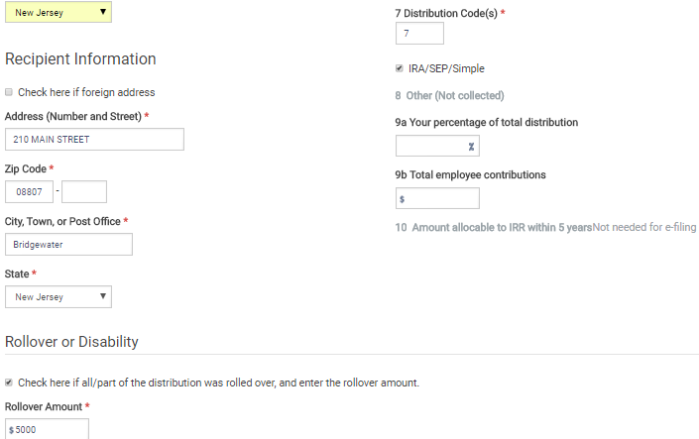
TS – 1099-R Rollover Federal section \ Income \ Enter Myself \ IRA/Pension Distributions (1099-R, 1099-SSA) \ Add or Edit a 1099-R
Gross distribution
Counselor must calculate taxable amount left after rollover and update Box 2a
Check if rollover
Amount rolled over
Notes:
If any of amount on 1099-R was rolled over into another retirement plan within the required 60 days, check the rollover box and enter the amount rolled over. TaxSlayer will exclude from taxable income
43

Slide 44
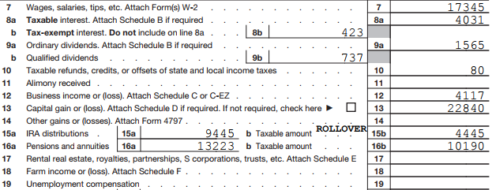
TS – Printed 1040 Line 15b - Showing Rollover
Gross IRA distributions
Taxable IRA distributions
Word ROLLOVER does not show on Summary/ Print 1040 – only on printed 1040
Notes:
Once amount is entered as Rollover amount on 1099-R screen, TaxSlayer will automatically include the word ROLLOVER at the beginning of Line 16 on the actual 1040 form (not on Summary/Print screen)
44

Slide 45
Public Safety Officer Pension
When accident, health or long-term care insurance premiums are deducted directly from pension check, a former Public Safety Officer is allowed up to a $3,000 reduction in taxable income
Enter in Federal section \ Income \ Enter Myself \ IRA/Pension Distributions (1099-R, 1099-SSA)
Do not include the insurance premiums (up to $3,000) in the taxable amount entered in Box 2a
Click on Options under Box 2a to enter the amount of premiums to be excluded from taxable income
Amounts entered as nontaxable cannot also be included on Schedule A as medical expenses
Notes:
How would we know? Client would have to disclose that they are public safety officer (Police, Fireperson, Rescue Squad, chaplain)
To avoid giving officer a double benefit, you cannot also deduct medical insurance premium on Sch A for these premiums
45

Slide 46
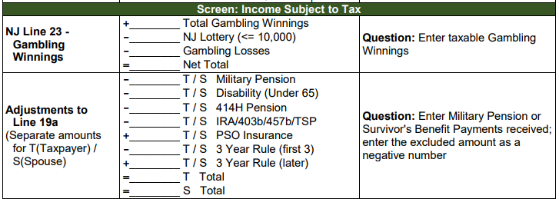
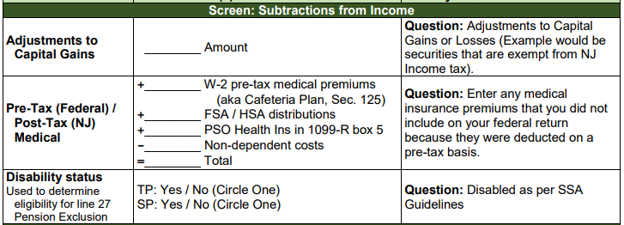
Public Safety Officer Pension
(cont’d)
Capture premium amount in NJ Checklist Income Subject to Tax and Subtractions from Income sections for later entry in the TaxSlayer State section
To add premiums back into taxable NJ Pension income on Line 19a,
since cannot be excluded for NJ
To add premiums to NJ medical expenses
Notes:
How would we know? Client would have to disclose that they are public safety officer (Police, Fireperson, Rescue Squad, chaplain)
To avoid giving officer a double benefit, you cannot also deduct medical insurance premium on Sch A for these premiums
46

Slide 47
TS – Options for Calculating Taxable Amount of Public Safety Officer Pension Distribution – Form 1099-R Federal section \ Income \ Enter Myself \ IRA/Pension Distributions (1099-R, 1099-SSA) \ Add or Edit a 1099-R
Click to enter premiums to be excluded from tax for Public Safety Officer
Notes:
47

Slide 48
TS – Distribution from Retirement Plan – Form 1099-R Federal section \ Income \ Enter Myself \ IRA/Pension Distributions (1099-R, 1099-SSA) \ Add or Edit a 1099-R \ Calculate Taxable Amount
Click to enter premiums to be excluded
from tax for Public Safety Officer
If you need to calculate taxable amount of Public Safety Officer distribution in addition to handling insurance premiums, click on Simplified General Rule Worksheet button instead
Notes:
48

Slide 49
TS – Distribution from Retirement Plan – Form 1099-R Federal section \ Income \ Enter Myself \ IRA/Pension Distributions (1099-R, 1099-SSA) \ Add or Edit a 1099-R \ Calculate Taxable Amount \ Public Safety Officers Distribution
Enter premiums to be excluded
from tax for Public Safety Officer
Notes:
49

Slide 50
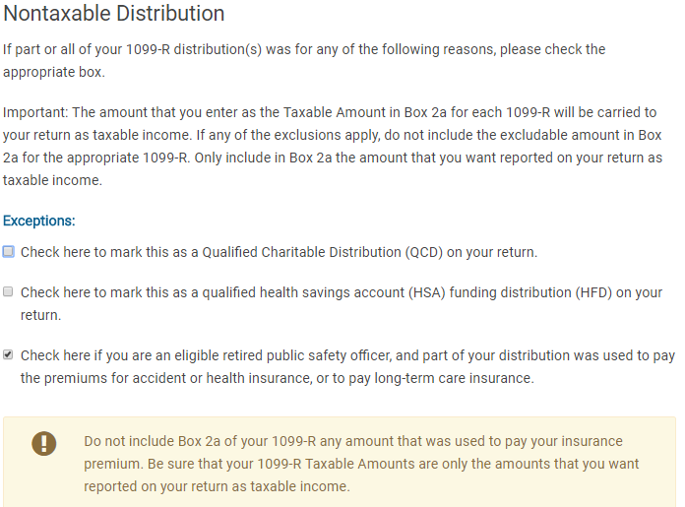
TS – Public Safety Officer Pension Federal section \ Income \ Enter Myself \ IRA/ Pension Distributions (1099-R, 1099-SSA) \ Nontaxable Distributions
TaxSlayer automatically checks after excludable premiums entered
Notes:
50

Slide 51
TS – Taxable Amount of Public Safety Officer Pension Distribution – Form 1099-R Federal section \ Income \ Enter Myself \ IRA/Pension Distributions (1099-R, 1099-SSA) \ Add or Edit a 1099-R
TaxSlayer calculates taxable
amount after excludable premiums are entered
Notes:
51

Slide 52
Tax-Free Exchanges
Certain distributions can be considered tax-free exchanges
Example – Return on contributions made to annuity
Must probe with taxpayer to really understand what 1099-R is showing
If part or all of distribution should really be nontaxable, subtract tax-exempt amount before entering taxable amount in Box 2a
Notes:
52

Slide 53
Other Special 1099-R Cases
If distribution is from an IRA that included non-deductible contributions (taxed at time of contribution)
Refer to an experienced counselor
Must complete Form 8606 Part III
Form 8606 Nondeductible IRAs Part I from prior years needed to determine taxable amount of distribution
Only enter taxable amount in Box 2a on 1099-R screen
See TaxPrep4Free.org Preparer page Special Topics Document “IRA Non-Deductible Contributions and Distributions”
Notes:
53

Slide 54
Other Special 1099-R Cases
(cont’d)
For conversion of a traditional IRA (with no non-deductible contributions) into a Roth IRA, distribution is taxable
Enter as normal on 1099-R screen
For distributions from a Roth IRA
Determine if distribution is a qualified distribution (Pub 4012 Page D-40)
If any part of distribution is non-qualified, requires completion of Form 8606 Part III - Out of Scope
If 1099-R shows Code Q in Box 7, all of the distribution is qualified and, therefore, not taxable
Enter as normal on 1099-R screen. TaxSlayer enters distribution amount on 1040 Line 15a Gross IRA Distributions, but nothing on Line 15b Taxable IRA Distributions
Notes:
54

Slide 55
NJ Retirement Income Topics
Special topics relating to NJ tax law on retirement income to be discussed on subsequent slides
Military pensions
NJ 1040 Pensions/Annuities/IRA Withdrawals (NJ 1040 Lines 19a/19b)
Rules on taxability of NJ retirement income
NJ IRA Worksheet for IRAs, 403b, 457b, Thrift Savings Plan
NJ contributory pensions
3-year rule for pensions
NJ pension exclusion
NJ other retirement income exclusions
Notes:
This is just a summary page to introduce some other special topics relating to retirement income that we will be discussing on subsequent slides. Do not discuss any of these topics in detail now. Just mention them so students will know what is coming

Slide 56
Military Pensions on NJ Return
Military pensions are not taxable in NJ
Amount of military pension will flow through from entry of 1099-R in Federal section, so must tell TaxSlayer to subtract this from NJ taxable income
Capture the amount of the military pension in NJ Checklist Income Subject to Tax section for later entry in TaxSlayer State section

Slide 57
NJ 1040 Line 19 Pensions/Annuities/IRA Withdrawals
NJ 1040 includes all distribution amounts from pensions, annuities, and IRAs on Line 19
NJ does not have separate lines for IRAs vs. pensions/annuities as Federal 1040 does
NJ 1040 Line 19a includes all the taxable distribution amounts
NJ 1040 Line 19b includes all excludable amounts
Total of Lines 19a + 19b should equal the total of all 1099-R Box 1s
Does not include 1099-Rs for distributions that are totally tax-exempt, such as military pensions, disability pensions for persons under 65, Railroad Retirement Tier 2 pensions. These items do not appear on NJ 1040 at all

Slide 58
NJ 1040 Line 19b – Excludable Pensions, Annuities, & IRA Withdrawals
NJ 1040 Line 19b is used to show the excludable portion of any distribution you received from a contributory pension, annuity, or IRA. This is the amount that represents your previously taxed contributions to the plan
To determine the excludable amount to enter, add together:
Non-taxable amounts calculated on the Simplified General Rule Worksheet
The difference amount anytime the 1099-R Box 1 (gross distribution) is different than Box 2a (taxable amount)

Slide 59
NJ 1040 Line 19b – Excludable Pensions, Annuities, & IRA Withdrawals
(cont’d)
The full amount received when using the Three-Year Rule until all of the contributions are recovered
Do not include pensions that are not taxed in NJ such as military pensions, disability pensions under 65, and Railroad Retirement Tier 2 pensions
Refer to TaxPrep4Free.org “NJ Special Handling” document on Preparer page for details

Slide 60
TS - Retirement Income on NJ 1040 Lines 19a & 19b
Line 19a: Taxable part of pensions/annuities/IRAs
Line 19b: Excludable part of pensions/annuities/IRAs

Slide 61
Rules on Taxability Of Retirement Income - NJ
Contribution | Contribution Made with After-NJ-Tax Money | Taxable on Distribution
Employer contributions | N/A | YES
Employee contributions paid with pre-tax dollars to 401K | NO | YES
Employee contributions paid with after-tax dollars (including IRA) | YES | NO
Earnings on both employer & employee contributions | N/A | YES
Notes:
Summary of taxability of different parts of retirement income

Slide 62
IRAs, 403b, 457b, Thrift Savings Plans
Distributions from IRAs, 403b, 457b, and Thrift Savings Plans (TSPs) are taxed in NJ except for the portion that represents taxpayer contributions
Contributions were made with after-NJ-tax money, so not taxed upon distribution
To determine NJ taxability amount of any of these distributions, the portion of the distribution that represents taxpayer contributions is allocated over expected number of distribution years
Taxpayer must know total contributions
May be able to get info for some of these plans from NJ Division of Pensions and Benefits or from plan administrator. Taxpayers would have to know IRA contributions from their own records
Use NJ IRA Worksheet on TaxPrep4Free.org to determine the taxable and nontaxable amounts (if contributions are known)

Slide 63
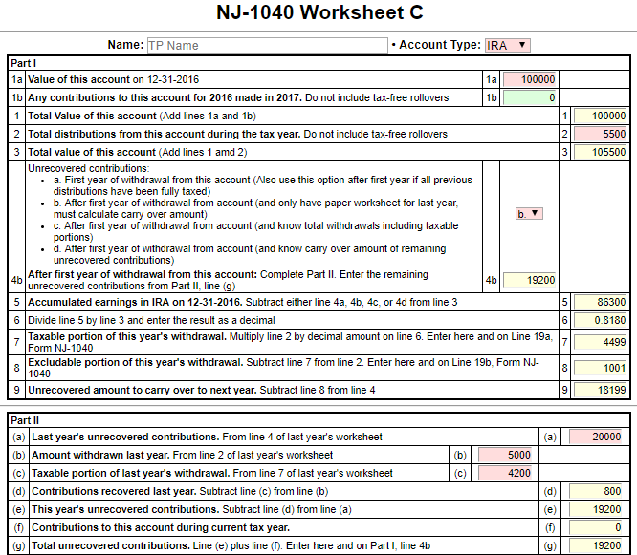
NJ IRA Worksheet on TaxPrep4Free.org to determine Taxable and Nontaxable Portions of IRAs, 403b, 457b, Thrift Savings Plans
Enter as adjustments to Lines
19a and 19b on NJ Checklist

Slide 64
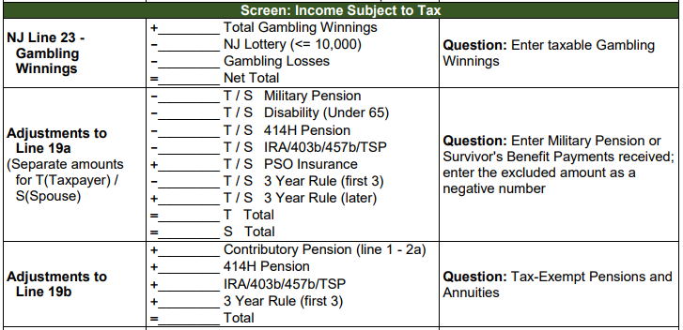
Adjustments on NJ Checklist to Reflect Taxable and Nontaxable Portions of IRAs, 403b, 457b, Thrift Savings Plans
Subtract tax-exempt amount
from Line 19a
Add tax-exempt amount to Line 19b

Slide 65
NJ Contributory Pensions
A retirement plan in which employee contributes a portion of base salary into pension plan. Employer may make contributions also
We see a lot of these for former NJ state and municipality workers
At retirement, retiree receives a set amount each month
Taxability of distribution depends on whether contributions were taxed when made
Federal tax treatment
Employee contributions made prior to 1/1/87 were made with after-tax money that was included in W-2 wages when contributed. Contributions after 1/1/87 were made with pre-tax money and not included in W-2 wages
Optional pension membership credit purchased before 2002 were also after-tax
At distribution, the pre-tax contributions plus employer contributions and earnings are taxable
After-tax contributions can be recovered evenly over taxpayer’s expected lifetime or combined lifetime with spouse (if joint and survivor annuity)
Notes:
For 414H pension for state or municipal workers, the NJ Division of Pensions and Benefits sends out a letter detailing the Federal after-tax employee contributions and the total employee contributions, along with associated instructions, when employee retires. If letter is not available, retiree can call Office of Client Services for the Pension Division at (609) 292-7524 or send an email to pensions.nj@treas.nj.gov
For other contributory pensions, retiree may be able to get needed information from pension plan administrator or former employer

Slide 66
NJ Contributory Pensions
(cont’d)
Federal after-tax contributions are shown on 1099-R in Box 9b. Usually current year’s excludable amount is shown in Box 5, and then reflected in the taxable amount shown in Box 2a
If taxable amount is not shown in Box 2a, use the Simplified General Rule Worksheet in TaxSlayer or the Bogart Annuity Calculator on TaxPrep4Free.org to determine the taxable amount, based on the amount in Box 9b
NJ tax treatment
All employee contributions are made with after-NJ-tax money that is included in W-2 NJ State Wages when contributed
Therefore, all employee contributions are tax-exempt upon distribution. Only employer contributions and earnings are taxable for NJ
To determine the NJ taxable amount, must use total employee contributions amount, not the amount shown in Box 9b
Insert total employee contributions in TaxSlayer Simplified General Rule Worksheet or Bogart Annuity Calculator to determine the NJ taxable and non-taxable amounts of the distribution
See Special Topics document “Contributory Pensions” of TaxPrep4Free.org for more details
Notes:
For 414H pension for state or municipal workers, the NJ Division of Pensions and Benefits sends out a letter detailing the Federal after-tax employee contributions and the total employee contributions, along with associated instructions, when employee retires. If letter is not available, retiree can call Office of Client Services for the Pension Division at (609) 292-7524 or send an email to pensions.nj@treas.nj.gov
For other contributory pensions, retiree may be able to get needed information from pension plan administrator or former employer

Slide 67
Example of NJ Contributory Pension
(cont’d)
1099-R Box 1 Gross Distribution $22,000
1099-R Taxable Amount Blank
1099-R Box 9b Employee Contributions $2,000
(Federal after-tax contributions amount)
Total Employee Pension Contributions
(provided by pension administrator or client) $50,000
Using Simplified General Rule Worksheet or Bogart Annuity Calculator:
Using Federal after-tax contributions of $2,000, the Federal taxable amount of the distribution is $21,908
Using total employee contributions of $50,000, the NJ taxable amount of the distribution is $19,692
See Special Topics document “NJ Contributory Pension” on TaxPrep4Free.org Preparer Page for help calculating the correct adjustment amounts for NJ 1040 Lines19a and 19b to enter on the NJ Checklist for later entry in TaxSlayer State section
Notes:
The Federal taxable amount of the distribution will flow through to NJ 1040 Line 19a. Therefore, you must adjust Line 19a to reflect the correct NJ taxable amount
The calculation is: Federal taxable amount minus NJ taxable amount = adjustment amount on NJ Checklist Line 19a. Enter as a negative number
You must also enter an adjustment for Line 19b to reflect the NJ nontaxable amount. This is shown as the excludable amount on the Bogart calculator. It is calculated as: Federal gross amount in 1099-R Box 1 – NJ taxable amount

Slide 68
NJ 3-Year Rule for Pensions Qualifications
May use NJ 3-Year Rule if:
Both you and employer contributed to plan
Will recover your contributions within 36 months of 1st distribution from plan
Must be just starting to collect pension
May exclude all pension distributions from income until distributions = contributions
If pension started in middle of year, could be partially taxable in last year of exclusion
Since Federal taxable amount flows through to NJ 1040 Line 19a, capture the amount that should be tax exempt under the 3-year rule in NJ Checklist Income Subject to Tax section for later entry in TaxSlayer State section
Notes:
To use the 3-year rule you must have started using the rule on the first year you took the distribution (or be able to go back and amend prior returns to show this)
This may be useful for people who retire before 62 ½ because they wouldn’t be eligible for other NJ pension exclusions yet
We do not see this situation very often because:
Taxpayer must have contributed to pension plan along with employer
Must be just starting to collect pension
Must be able to recover all employee contributions within 3 years of first pension payment
Pension Exclusion & Other Retirement Income Exclusions may be enough to exclude all pension income from NJ tax
Check prior year’s NJ return and/or ask taxpayer to see if taxpayer was using 3-year rule for pension last year. If so, use following instructions to continue adjusting NJ return until pension payments = employee contributions

Slide 69
NJ 3-Year Rule for Pensions Qualifications
Once all contributions are recovered under 3-year rule, all of pension distributions will be taxable for NJ. Capture the amount of pension income to be added back into taxable NJ pension income on Line 19a in NJ Checklist Income Subject to Tax section for later entry in TaxSlayer State section
See “NJ Special Handling” document on TaxPrep4Free.org Preparer page for details on entering 3-year rule
Notes:
To use the 3-year rule you must have started using the rule on the first year you took the distribution (or be able to go back and amend prior returns to show this)
This may be useful for people who retire before 62 ½ because they wouldn’t be eligible for other NJ pension exclusions yet
We do not see this situation very often because:
Taxpayer must have contributed to pension plan along with employer
Must be just starting to collect pension
Must be able to recover all employee contributions within 3 years of first pension payment
Pension Exclusion & Other Retirement Income Exclusions may be enough to exclude all pension income from NJ tax
Check prior year’s NJ return and/or ask taxpayer to see if taxpayer was using 3-year rule for pension last year. If so, use following instructions to continue adjusting NJ return until pension payments = employee contributions

Slide 70
NJ Pension Exclusion Qualifications
You &/or spouse/CU partner 62 years+ or blind or disabled (according to SSA guidelines) on last day of year
If only 1 partner qualifies, can still claim up to maximum pension exclusion. However, only retirement income of qualified partner can be excluded
Note the fact that taxpayer and/or spouse is disabled according to SSA guidelines in NJ Checklist Subtractions from Income section for later entry in the State section
Total income from NJ 1040 Line 26 $100K or less

Slide 71
NJ Pension Exclusion Annual Amounts
Based on filing status:
$20K/$40K (2017) – MFJ
$15K/$30K (2017) – Single, HOH, QW
$10K/$20K (2017) – MFS
Maximum exclusion cannot exceed total Pension, Annuity & IRA Withdrawal amount on NJ 1040 Line 19a
Notes:
Pension exclusion claimed on NJ 1040 Line 27a may be less than the maximum exclusion because total Pension, Annuity & IRA Withdrawal amount on Line 19a is less than the maximum

Slide 72
Other Retirement Income Exclusions - NJ1040 Line 27b
2 Parts to Other Retirement Income Exclusions
Unclaimed portion of your Pension Exclusion (NJ 1040 line 27a)
Special exclusion for taxpayers who are unable to receive SS or RR benefits
Each part has different eligibility requirements

Slide 73
Other Retirement Income Exclusions: Unclaimed Pension Exclusion
Did not use maximum Pension Exclusion
You &/or spouse/CU partner 62 years+
Total income from NJ 1040 Line 26 $100K or less
Income from wages, net profit from business, partnership, S corp. income </= $3K
Amount will be maximum pension exclusion minus pension exclusion claimed on NJ 1040 Line 27a
Notes:
Income from wages, net profit from business is made up of NJ 1040 Lines 14+17+20+21

Slide 74
NJ Other Retirement Income Exclusions: For Taxpayers Unable to Receive SS/RR Benefits
Not related to Pension Exclusion & may claim whether or not you use maximum Pension Exclusion
Exclusion amounts $6K – MFJ, HOH, QW; $3K – Single, MFS
You &/or spouse/CU partner 62 years+
Unable to receive SS/RR benefits, but would have been eligible for benefits had you fully participated in either program
Must answer questions under Pension Exclusion in State section \ Edit \ Enter Myself \ Subtractions from Income for TaxSlayer to determine eligibility

Slide 75
TS – Additional Questions for Other Retirement Income Exclusion State Section \ Edit \ Enter Myself \ Subtractions from Income
Questions to determine eligibility for
Other Retirement Income exclusion

Slide 76
Other Topics Relating to Retirement Income
Special topics relating to retirement income to be discussed on subsequent slides
Railroad Retirement Benefits Tier 2
Disability income reported on 1099-R
Prior to retirement age
After retirement age
IRA Penalties
Non-deductible contributions to an IRA
Tracking contributions to establish cost basis
Distributions from IRAs containing non-deductible contributions
Notes:
This is just a summary page to introduce some other special topics relating to retirement income that we will be discussing on subsequent slides.
Do not discuss any of these topics in detail now. Just mention them so students will know what is coming
76

Slide 77
Railroad Retirement Benefits Tier 2 (Pension Equivalent)
Railroad Retirement Tier 2 (Pub 575)
Reported on RRB-1099-R - Green Form
Same rules as pensions
RRB-1099-R Pension (not taxable in NJ)
TaxSlayer automatically excludes the railroad retirement pension amount from NJ income
Notes:
77

Slide 78
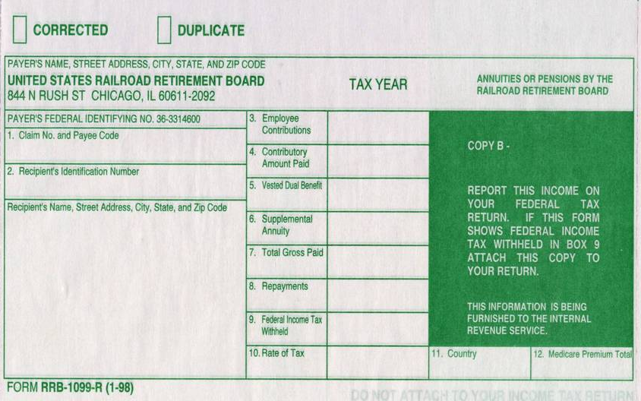
Sample Railroad Retirement (RR) Benefits Tier 2
Employee contributions
Gross paid
Federal income tax withheld
Sch A Medical
Notes:
This is a sample 1099-R for Railroad Retirement Benefits – Tier 2
78

Slide 79
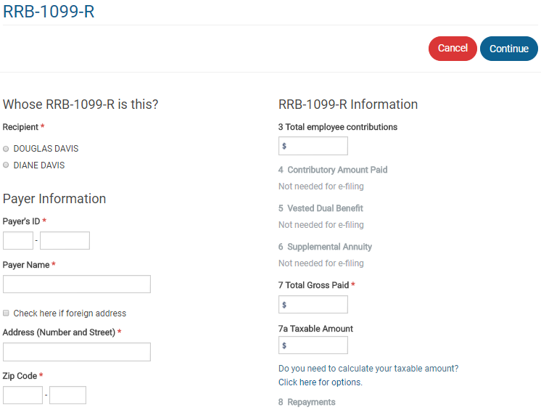
TS – Railroad Retirement Benefits Tier 2 Federal section \ Income \ Enter Myself \ IRA/ Pension Distributions (1099-R, 1099-SSA) \ RRB-1099-R
Employee contributions
Gross paid
Taxable amount
Notes:
Railroad Retirement Benefits on RRB-1099-R has a separate entry screen from regular 1099-R
79

Slide 80
Railroad Retirement Benefits Tier 2 – TS Tips
Enter in Federal section \ Income \ Enter Myself \ IRA/Pension Distributions (1099-R, 1099-SSA) \ RRB-1099-R
Copy information from printed RRB-1099-R into equivalent boxes on screen
Click link to Simplified General Rule Worksheet if needed to determine taxable amount (if Box 7a is not populated) OR
Use Bogart Annuity Calculator on TaxPrep4Free.org Preparer page
Notes:
80

Slide 81
Disability Income Reported on 1099-R
If disability income is reported on 1099-R:
1099-R, Box 2 shows taxable amount
1099-R, Code 3 in Box 7 indicates disability
Before taxpayer has reached minimum retirement age (as defined by employer), income is considered wages, not pension
Check box on 1099-R screen so that TaxSlayer will include as wages on 1040 Line 7
After taxpayer reaches minimum retirement age, income is reported as taxable pension on 1040 Line 16b
Notes:
PREVIOUSLY COVERED UNDER WAGES
Note: Normal retirement age is determined by employer. Counselor can find out by asking client. If client doesn’t know, can call employer
81

Slide 82
Disability Income on Form 1099-R
2016
Taxable amount
Code 3 is Disability
3
Notes:
Sample 1099-R showing disability income. If taxpayer is below retirement age, the amount in Box 2a should transfer to 1040 Line 7 Wages, rather than 1040 Line 16b Taxable Pension
82

Slide 83
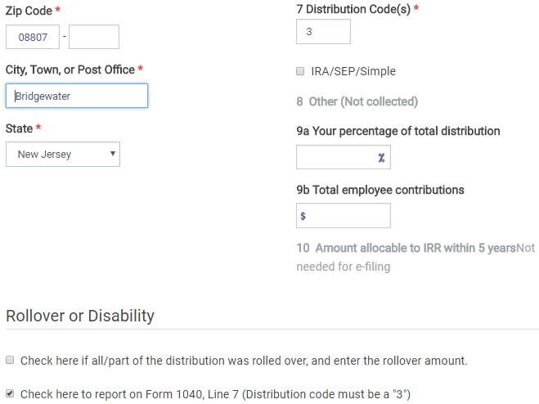
TS – Disability Income Reported on 1099-R Federal section \ Income \ Enter Myself \ IRA/Pension Distributions (1099-R, 1099-SSA) \ Add or Edit a RRB-1099-R
Code for disability
Check if recipient under minimum retirement age & amount should be reported as wages on 1040 Line 7
Notes:
If code in Box 7 is 3 (person on disability under retirement age), check Box that says, “Check here to report on Form 1040, Line 7.” TaxSlayer will put the 1099-R amount as Wages on 1040 Line 7, rather than as Pension on 1040 Line 16
83

Slide 84
Disability Pension on NJ Return
Disability pension is taxed differently in NJ depending on age of recipient
Recipient under age 65 – disability pension is tax exempt
Recipient age 65 or older – disability pension is treated as a regular pension
Amount of disability pension flows through to NJ pension line 19a from entry of 1099-R in Federal section
Does not matter whether disability pension is treated as pension or wages on the Federal return (i.e. – whether recipient is under or over company minimum retirement age)
If disability should be tax exempt because recipient is under age 65, capture the amount of the disability pension in the NJ Checklist Income Subject to Tax section for entry later in the State section
TaxSlayer does not automatically remove this disability pension from NJ 1040 Line 19a for Pensions

Slide 85
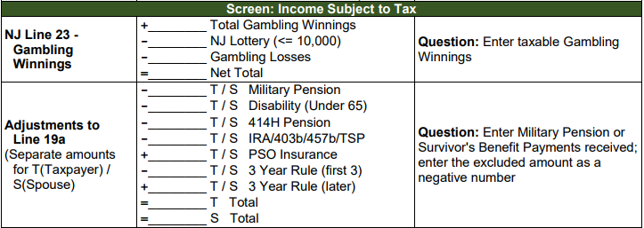
Disability Pension on NJ Return
(cont’d)

Slide 86
IRA Penalties
Early distribution penalty (prior to age 59½ )
Additional tax of 10%
Certain exceptions to penalty – Codes 2, 3 or 4 in 1099-R Box 7 – don’t need Form 5329. TaxSlayer handles automatically
If Code 1 (no known exception) in 1099-R Box 7, TaxSlayer will calculate appropriate penalty after you answer some additional questions:
Choose Retirement Plan when asked, “What type of plan did you receive this distribution from?”
Probe with taxpayer to determine if qualified for an exemption to penalty
Notes:
3 different types of IRA penalties
Early distribution penalty – 10% of withdrawal
Excess contributions penalty – 6% of excess contribution
Failure to take Required Minimum Distribution (RMD) penalty – 50% of amount of RMD not taken
86

Slide 87
IRA Penalties
(cont’d)
If distribution is exempt, enter amount to be excluded from penalty and reason on Form 5329 Part I under Other Taxes section
TaxSlayer calculates appropriate penalty (if any) & carries to 1040 Line 59 in Other Tax section
Excess contributions penalty – Out of Scope
Additional tax - 6% of excess contribution for as long as excess remains in IRA
Notes:
87

Slide 88
Form 5329 – Exclusions to 1099-R Box 7 Code 1 Penalty for Early Distribution
Pub 4012 Tab H
Form 5329 Part I is used to calculate penalty
Sample exclusion codes
03 – Distributions due to total and permanent disability
05 – Qualified retirement plan distributions up to (1) the amount you paid for unreimbursed medical expenses during the year minus (2) 7.5%/10% of your adjusted gross income for the year.
08 – IRA distributions made for higher education expenses.
09 – IRA distributions made for purchase of a first home, up to $10,000.
12 – Other (e.g.-Distributions incorrectly indicated as early distributions by code 1, J, or S in box 7 of Form 1099-R. Include on Line 2 the amount you received when you were age 59½ or older)
Notes:
Always explore circumstances of an early distribution with taxpayer to determine if there is a possible exemption to the 10% penalty
88

Slide 89
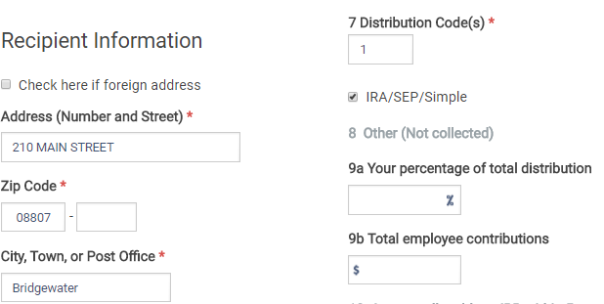
TS – Early Distribution Penalty Federal section \ Income \ Enter Myself \ IRA/Pension Distributions (1099-R, 1099-SSA) \ Add or Edit a 1099-R
Early distribution; no known exception

Slide 90
TS – Early Distribution Penalty Federal section \ Income \ Enter Myself \ IRA/Pension Distributions (1099-R, 1099-SSA) \ Add or Edit a 1099-R \ Form 1099-R Distribution Penalty
Type of plan distribution received from
Notes:
This screen only appears if 1099-R Box 7 shows a distribution code of 1, which is an early distribution where the issuer does not know of any valid exception

Slide 91
TS – Early Distribution Penalty Federal section \ Other Taxes \ Tax on Early Distribution (Form 5329)
Early distributions not subject to 10% penalty
Reason for exemption

Slide 92
IRA Penalties
(cont’d)
Failure to take full Required Minimum Distribution (RMD) penalty
Counselor not expected to review all plans and verify that required distributions were taken
Can request waiver if:
Taxpayer missed taking all or part of RMD
Shortfall in amount of distribution due to reasonable error
Taxpayer is taking reasonable steps to remedy shortfall
Use Form 5329 Part IX to request waiver
Enter waiver request in Federal Section \ Other Taxes \ Tax on Early Distribution Form 5329
Notes:
92

Slide 93
Waiver Request for Failure to take RMD Federal section \ Other Taxes \ Tax on Early Distribution (Form 5329)
(cont’d)
RMD that should have been taken
Amount actually taken
Waiver for additional tax
Explanation for waiver
Notes:
93

